Slide 1
LMS using Cloud

Slide 2
Chapter 4: Introduction to System Analysis
Definition: System analysis as a methodical process for examining procedures and goals
Importance: Significance of system analysis in enhancing efficiency and efficacy
Objective: Identifying and addressing challenges to optimize e-learning platforms

Slide 3
Chapter 4: Data Collection Techniques
Definition: Data collection Is a pivotal stage in understanding user needs and requirements
Approach: Integration of qualitative and quantitative techniques for comprehensive insights
Rationale: Importance of data collection in informing the development and optimization of e-learning platforms

Slide 4
Chapter 4 :Feasibility Study and Requirements Analysis
Definition: Data collection Is a pivotal stage in understanding user needs and requirements
Approach: Integration of qualitative and quantitative techniques for comprehensive insights
Rationale: Importance of data collection in informing the development and optimization of e-learning platforms

Slide 5
Chapter 4 :User Characteristics and Conclusion
User Characteristics: Identifying characteristics of intended users, such as mobile literacy and navigation skills
Conclusion: Recap of key findings and implications for e-learning platform development
Next Steps: Future considerations and actions for further refinement and optimization of the platform

Slide 6
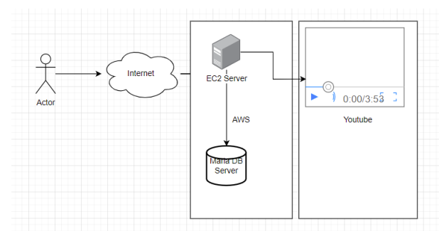
Chapter 5 :Introduction
Introduction
System design is the process of defining the elements of a system such as the architecture, modules and components, the different interfaces of those components and the data that goes through that system. It is meant to satisfy specific needs and requirements of a business or organization through the engineering of a coherent and well-running system.
Architecture – Tier 3
System implementation – Modal View Controller(MVC Pattern)

Slide 7
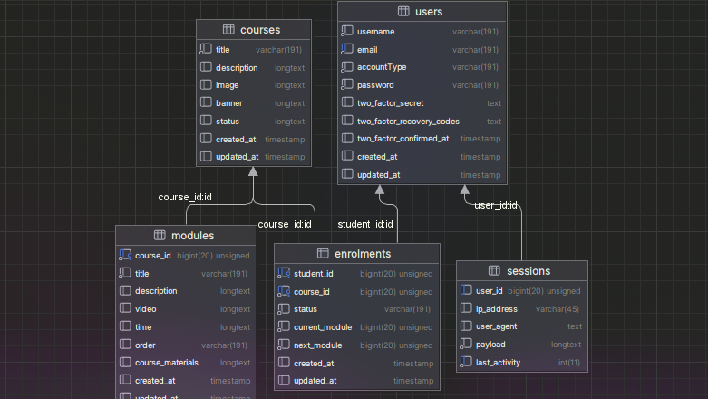
Chapter 5 :ERD
ERD
Database Design is a collection of processes that facilitate the designing, development, implementation and maintenance of enterprise data management systems. The main objectives of database designing are to produce logical and physical designs models of the proposed database system.

Slide 8





Chapter 6: Introduction
Introduction
This chapter elaborates the Implementation issues of how the system design was implemented in terms of database implementation; application implementation for presentation or the user interface. The purpose of implementation was to transform the system design and the functional requirements into the actual system being developed. Planning for it begins early in the design stage. It covers the following areas:
Training of employees ,Programming ,System testing Changeover procedure and Review and maintenance
Tools Used

Slide 9
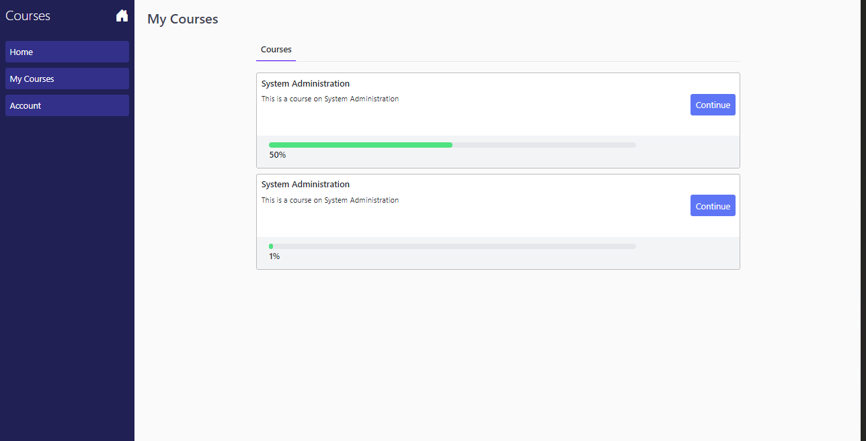
Chapter 7: Recommendation
In summary, we recommend implementing a robust testing strategy for the LMS system, incorporating continuous testing, user feedback mechanisms, monitoring, and maintenance practices. Additionally, ensure scalability and flexibility in system design, provide comprehensive user training and support, and prioritize user satisfaction and usability. By following these recommendations, we can optimize the performance, reliability, and user experience of the LMS system, supporting its successful deployment and ongoing operation within the organization.

